Slide 1

Advanced course
Lesson 27
DIY coures（5）
Traffic indicator
YahBoom Croco:Kit tutorial

Slide 2
Advanced course
Content
Part1
Part 2
Part3
Part 4
Part 5
Learning goals
Preparation
Connection
Search for blocks
Combine blocks
YahBoom Croco:Kit tutorial

Slide 3
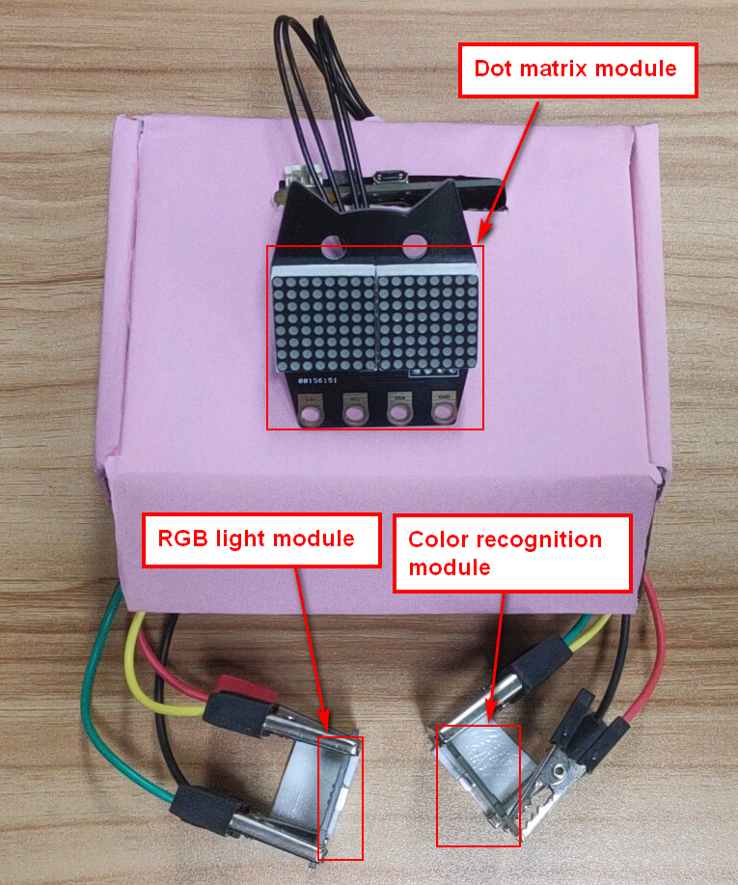
Advanced course
Part 1
Learning goals
After downloading the program, we can see the word 'Hello!' on the Micro:bit LED dot matrix.
The RGB light become green, when the color sensor detects green, the dot matrix module displays a moving person. After 10 seconds, the RGB light become red, when the color sensor detects red, the dot matrix module displays a standing person. The RGB lamp switches color every 10 seconds.
YahBoom Croco:Kit tutorial

Slide 4
Advanced course
Part 2
Hardware:
● 1 X Micro:bit Board
● 1 X Micro USB Cable
● 1 X Diamond breakout
● 1 X Photosensitive module
● 8 X Alligator clip
● 1 X RGB light module
● 1 X Dot matrix module
● 1 X Color recognition module
● 1 X PC
Preparation
Mode 1 online programming: First, we need to connect the micro:bit to the computer by USB cable. The computer will pop up a USB flash drive and click on the URL in the USB flash drive: http://microbit.org/ to enter the programming interface. Add the Yahboom package: https://github.com/lzty634158/Croco-Kit to program.
Mode 2 offline programming: We need to open the offline programming software. After the installation is complete, enter the programming interface, click【New Project】, add Yahboom package: https://github.com/lzty634158/Croco-Kit , you can program.
YahBoom Croco:Kit tutorial

Slide 5
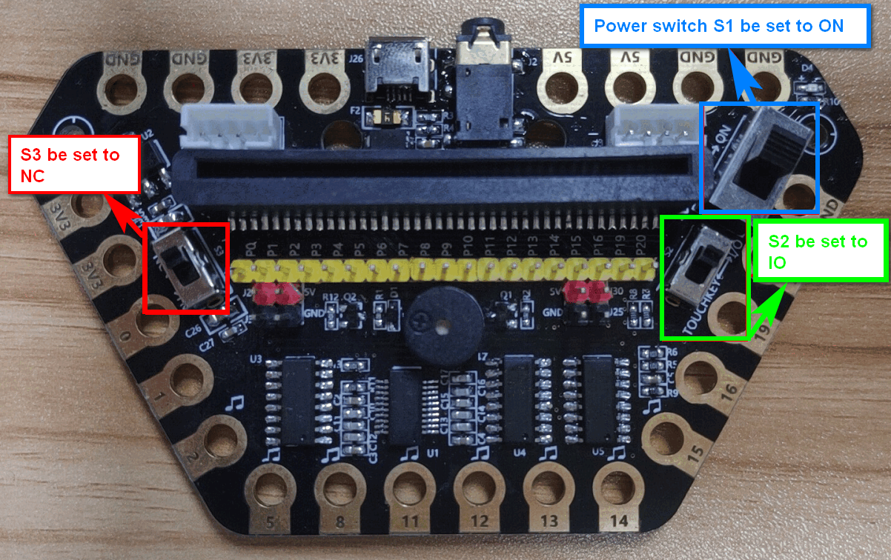
Advanced course
Part 2
Preparation
! ! !Note: S1 be set to the ON, S2 be set to the IO, and S3 to the NC.
YahBoom Croco:Kit tutorial

Slide 6
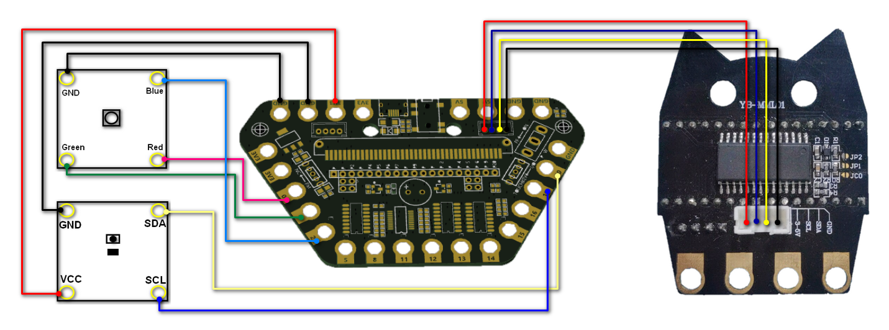
Advanced course
Part 3
Connection
YahBoom Croco:Kit tutorial

Slide 7
Advanced course
Part 3
Expansion board | RGB light Module | Dot matrix module | Color recognition module
P0 | Red
P1 | Green
P2 | Blue
P19 |  |  | SCL
P20 |  |  | SDA
3.3V | VCC
GND | GND |  | GND
J3 socket |  | through 4pin cable
Connection
YahBoom Croco:Kit tutorial

Slide 8
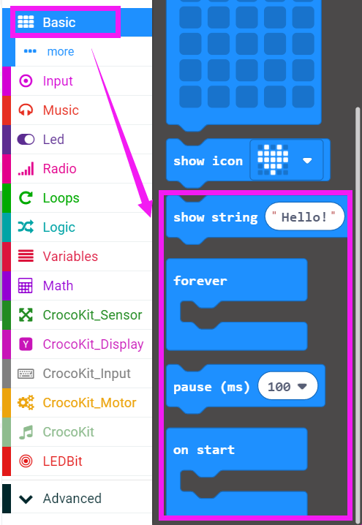
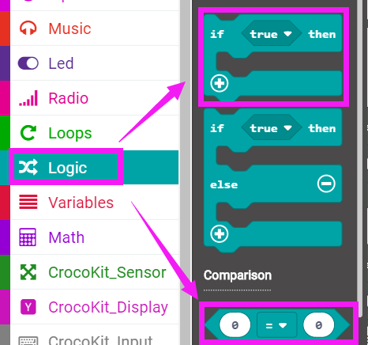
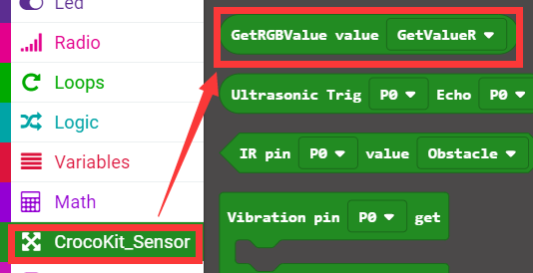
Advanced course
Part 4
Search for blocks
YahBoom Croco:Kit tutorial

Slide 9
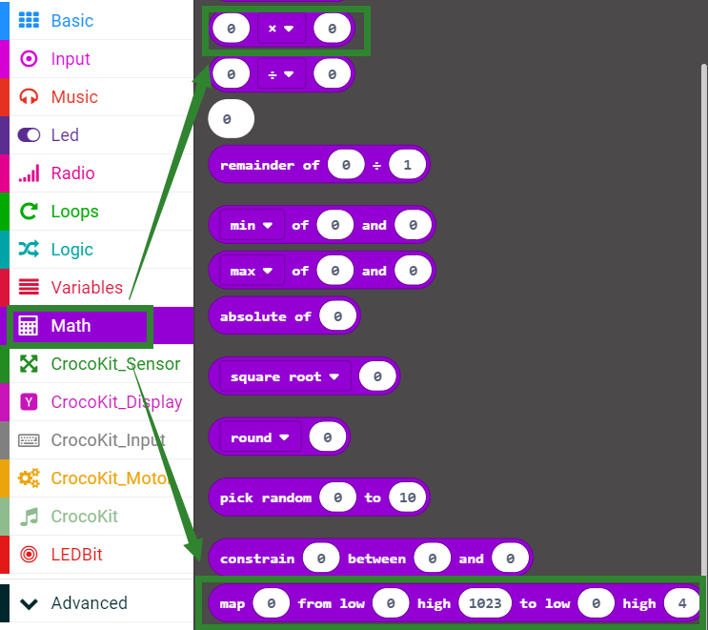
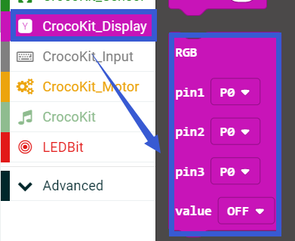
Advanced course
Part 4
Search for blocks
YahBoom Croco:Kit tutorial

Slide 10
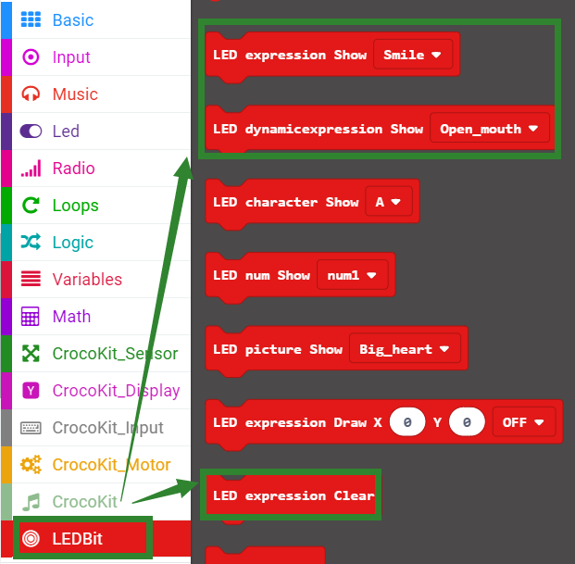
Advanced course
Part 4
Search for blocks
YahBoom Croco:Kit tutorial

Slide 11
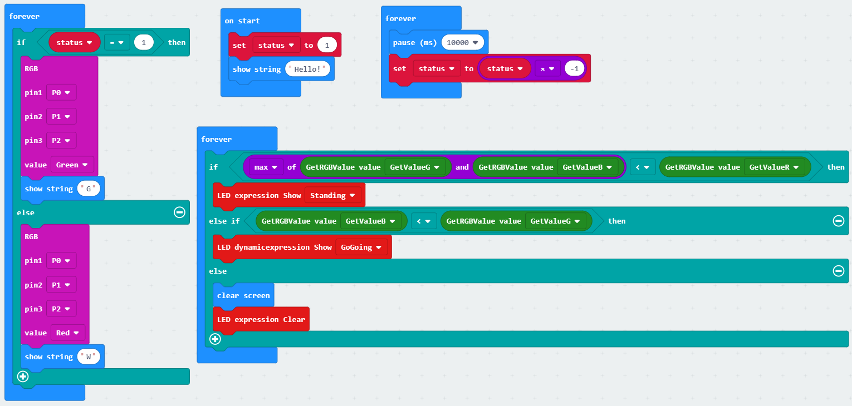
Advanced course
Part 5
Combine blocks
YahBoom Croco:Kit tutorial

Slide 12
Advanced course
Thank you ！
Powered by YahBoom
YahBoom Croco:Kit tutorial

